Slide 1

Lighting Our Way to a Sustainable Future
Grace • Courage • Wonder • Beyond

Slide 2
Why Solar at St. Luke’s
As people of faith, caring for the environment is a spiritual responsibility.
Faithful stewardship of God’s creation
Alignment with United Methodist Social Principles
Financial sustainability for decades to come
Our United Methodist Social Principles are clear about our church’s commitment to care for God’s creation when it says…
“The whole earth is God’s good creation and as such has inherent value. We are aware that the current utilization of energy resources threatens this creation at its very foundation.”

Slide 3
Why Now?
We have a unique opportunity to lead by example
Immediate financial benefits alongside long-term stewardship
Other faith communities have been successful before us

Slide 4
What Is Being Proposed?
Install 371 rooftop solar panels.
Reduce electricity costs over time.
Installed by Complete Energy Solutions (CES).
Notes:
The basic idea is to install solar panels on the roof of the church.
We’ve been working with a company called Complete Energy Solutions, who has done similar projects for other churches, and we believe they’re a great fit for us.

Slide 5
Solar Power, Right When We Need It Most
Kilowatt Hours
Hours of the Day
Most of our electricity use happens when the sun is shining—solar offsets it directly

Slide 6
Financial Summary at a Glance
Immediate electricity savings (~$20,000/year)
Net cash flow turns positive in Year 3
Loan is covered by utility savings + solar incentives
Cumulative cash flow turns positive:
-With Tax Credit: in Year 6
-Without Tax Credit: in Year 22
(See page 27-28 for complete cashflow models)

Slide 7
What If We Don’t Get the Rebate?
Even without the rebate, the project still provides long-term value.
While we fully expect to qualify for the full 40% federal tax credit, delays or supply chain issues could impact timing or eligibility.
The good news:
Our financing plan assumes funding first, and rebate later
Even without the rebate, we see positive cash flow in Year 3
The system will still generate thousands in annual energy savings and reduce our carbon footprint
Bottom line: The project is worth doing—rebate or not.

Slide 8
How We Will Pay for It
Now that the ”Big Beautiful Bill” has passed, our picture is clear why this plan makes sense, but we need to act soon
Our goal is to raise $250,000—equal to half of the expected project costs—through pledges and donations.
The other half will be financed through a loan from Methodists Helping Methodists.
If construction starts before the end of 2025, we will qualify for the full federal credit.
As long as the system is operational by the end of 2027, we’ll receive the credit.
The credit can be used to help repay the loan or cover other needs.
Addresses both major concerns: rebate uncertainty and overall debt.
Funding first. Rebate later. Debt lower either way—even if rebate is delayed or reduced.

Slide 9
Cash Flow Timing How We’ll Match Money In With Money Out
We’ve carefully aligned when we receive funding with when we need to make payments—so we can stay on track without delays or shortfalls.
The total project cost is $501,000, with payments due in phases from Oct 2025 to Mar 2026
Funding comes in three planned waves of congregational giving:
$140,000 by 12/31/25
$180,000 by 3/31/26
$250,000 by 10/31/26
A $250,000 loan ensures early costs are covered before gifts are received
Church reserves (temporarily used) are repaid as pledges come in
Loan payments (~$40,000 in 2026) are included in our planning
This is about timing—not just where the money comes from,
but making sure it’s there when we need it.

Slide 10
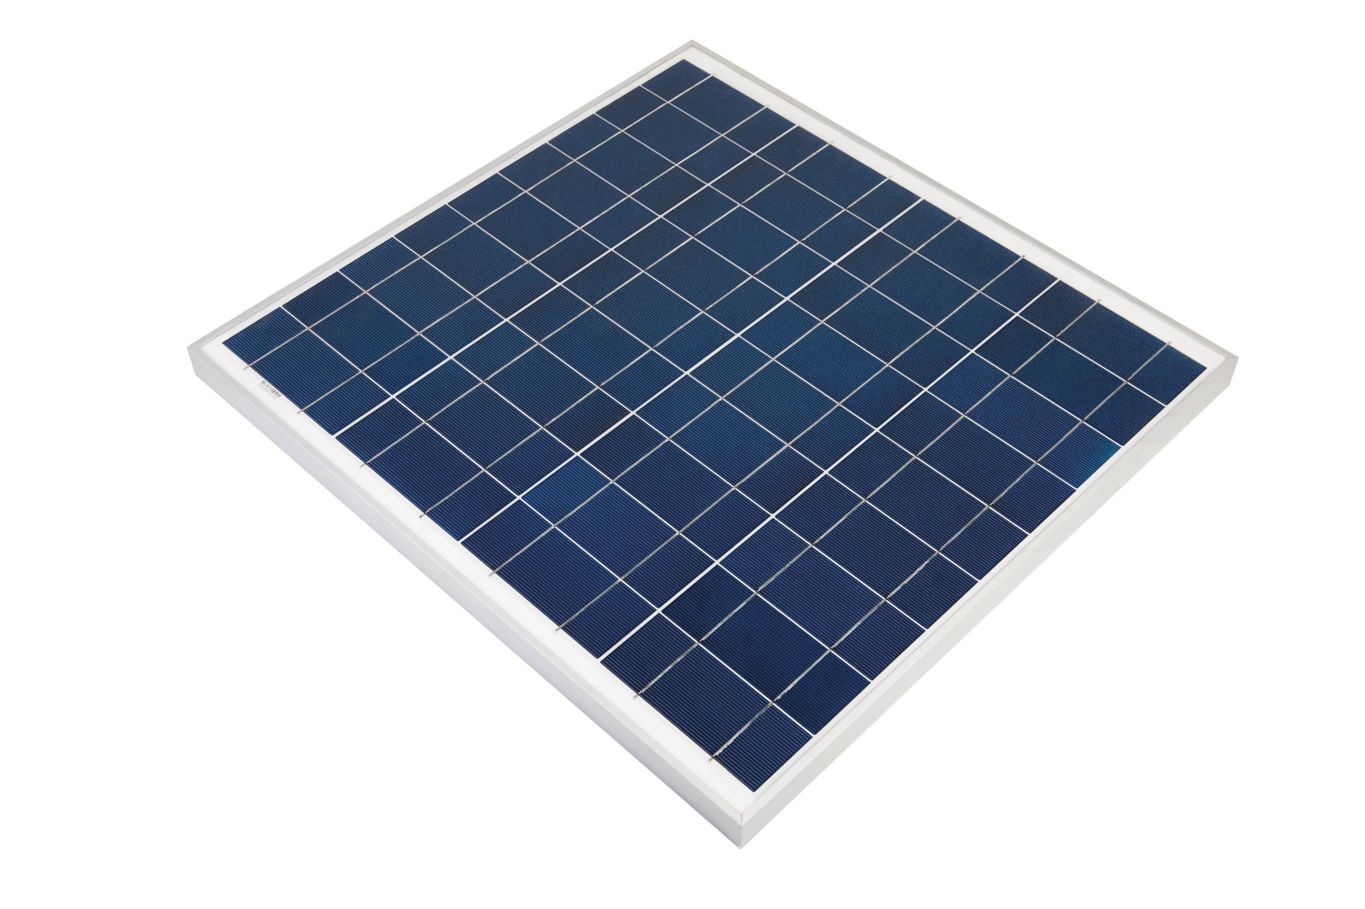
What’s the Ask?
Goal: Raise $250,000 (50% of total project cost)
Confirmed pledges of $83,000 so far
Remaining needed: $167,000
Source | Amount | Notes
Anonymous Gift (pledged) | $50,000 | Already committed
Giving Intents So far | $33,000 | Received from early interest
Remaining to Raise | $167,000 | To fully reach $250,000 goal
Sponsor a panel for $750

Slide 11
How Does Your Contribution Help?
Sponsor a panel (There are 371 at $750 each)
Support financial stability for the church
Long-term savings support ministry, not just utilities
Let us know your interest during our pledge drive (Aug–Sept) so that we can plan the project

Slide 12
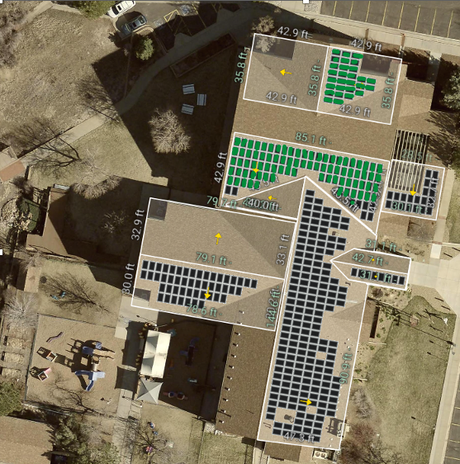
Sponsor a Panel and “Turn our roof GREEN”!
There will be a total of 371 solar panels installed on the roof at St. Luke’s.
Each green dot in this photo represents commitments already made to help St Luke’s realize the goal of a sustainable energy future!

Slide 13
Approvals We Need
External:
District Superintendent
Location & Building Committee
Methodists Helping Methodists loan committee
Internal:
Executive Team
Congregational vote in Charge Conference

Slide 14
Project Milestones
We are on a clear and achievable path: If we stay on track, construction will begin in December, and we’ll meet our $150K goal by March—fully repaying reserve funds by Fall 2026.
July
August
September
October
December
March
April-October
27th: Fundraising Launch
Presentations & Communications
Church Conference Vote
District Approval
Loan Fee Paid
Construction Begins
$150k Pledge Goal
Reserve Funds Repaid from Pledges
10: Pledge Drive
Loan Approval
2025
2026

Slide 15
Next Steps & How to Participate
Pray, pledge, promote
We will have a ‘soft campaign start, in summer, stronger emphasis in the fall

Slide 16
Thank You!
We appreciate your support and stewardship
Remember, this project has a long-term impact on St. Luke’s mission!
Let’s turn our roof green and our faith into action!

Slide 17
appendix
Electric Billing Explanation
Cash Flow Analysis
Technical Q&A/Frequently Asked Questions
Detailed financial assumptions (loan terms, tax credits, etc.)
Panel Sourcing and material details

Slide 18
How Does St Luke’s Electric Bill Work?
Our current bills average about $33,000 a year
It’s different than your home bill…
Demand Charges (70% of our bill):
Based on our highest 15-minute electricity spike each month
More like a toll on how hard we hit the system during busy moments
Summer spikes = higher rates
Energy Charges (24% of our bill):
Based on how much total electricity we use
We’re charged less than a penny per kilowatt-hour
Fixed Fees (6% of our bill)
Bottom Line:
Most of our cost comes from WHEN we use power, not just how much
Solar helps reduce both demand spikes and total energy costs

Slide 19

How Would We Pay for the Project?
50% of the costs of the project to be raised by a Church Capital Campaign
20-year loan from Methodists Helping Methodists Foundation
40% of the costs to be covered by rebates:
30% Federal Investment tax credit, plus
10% for U.S. materials
Xcel Energy provides a solar credit to lower costs further.

Slide 20
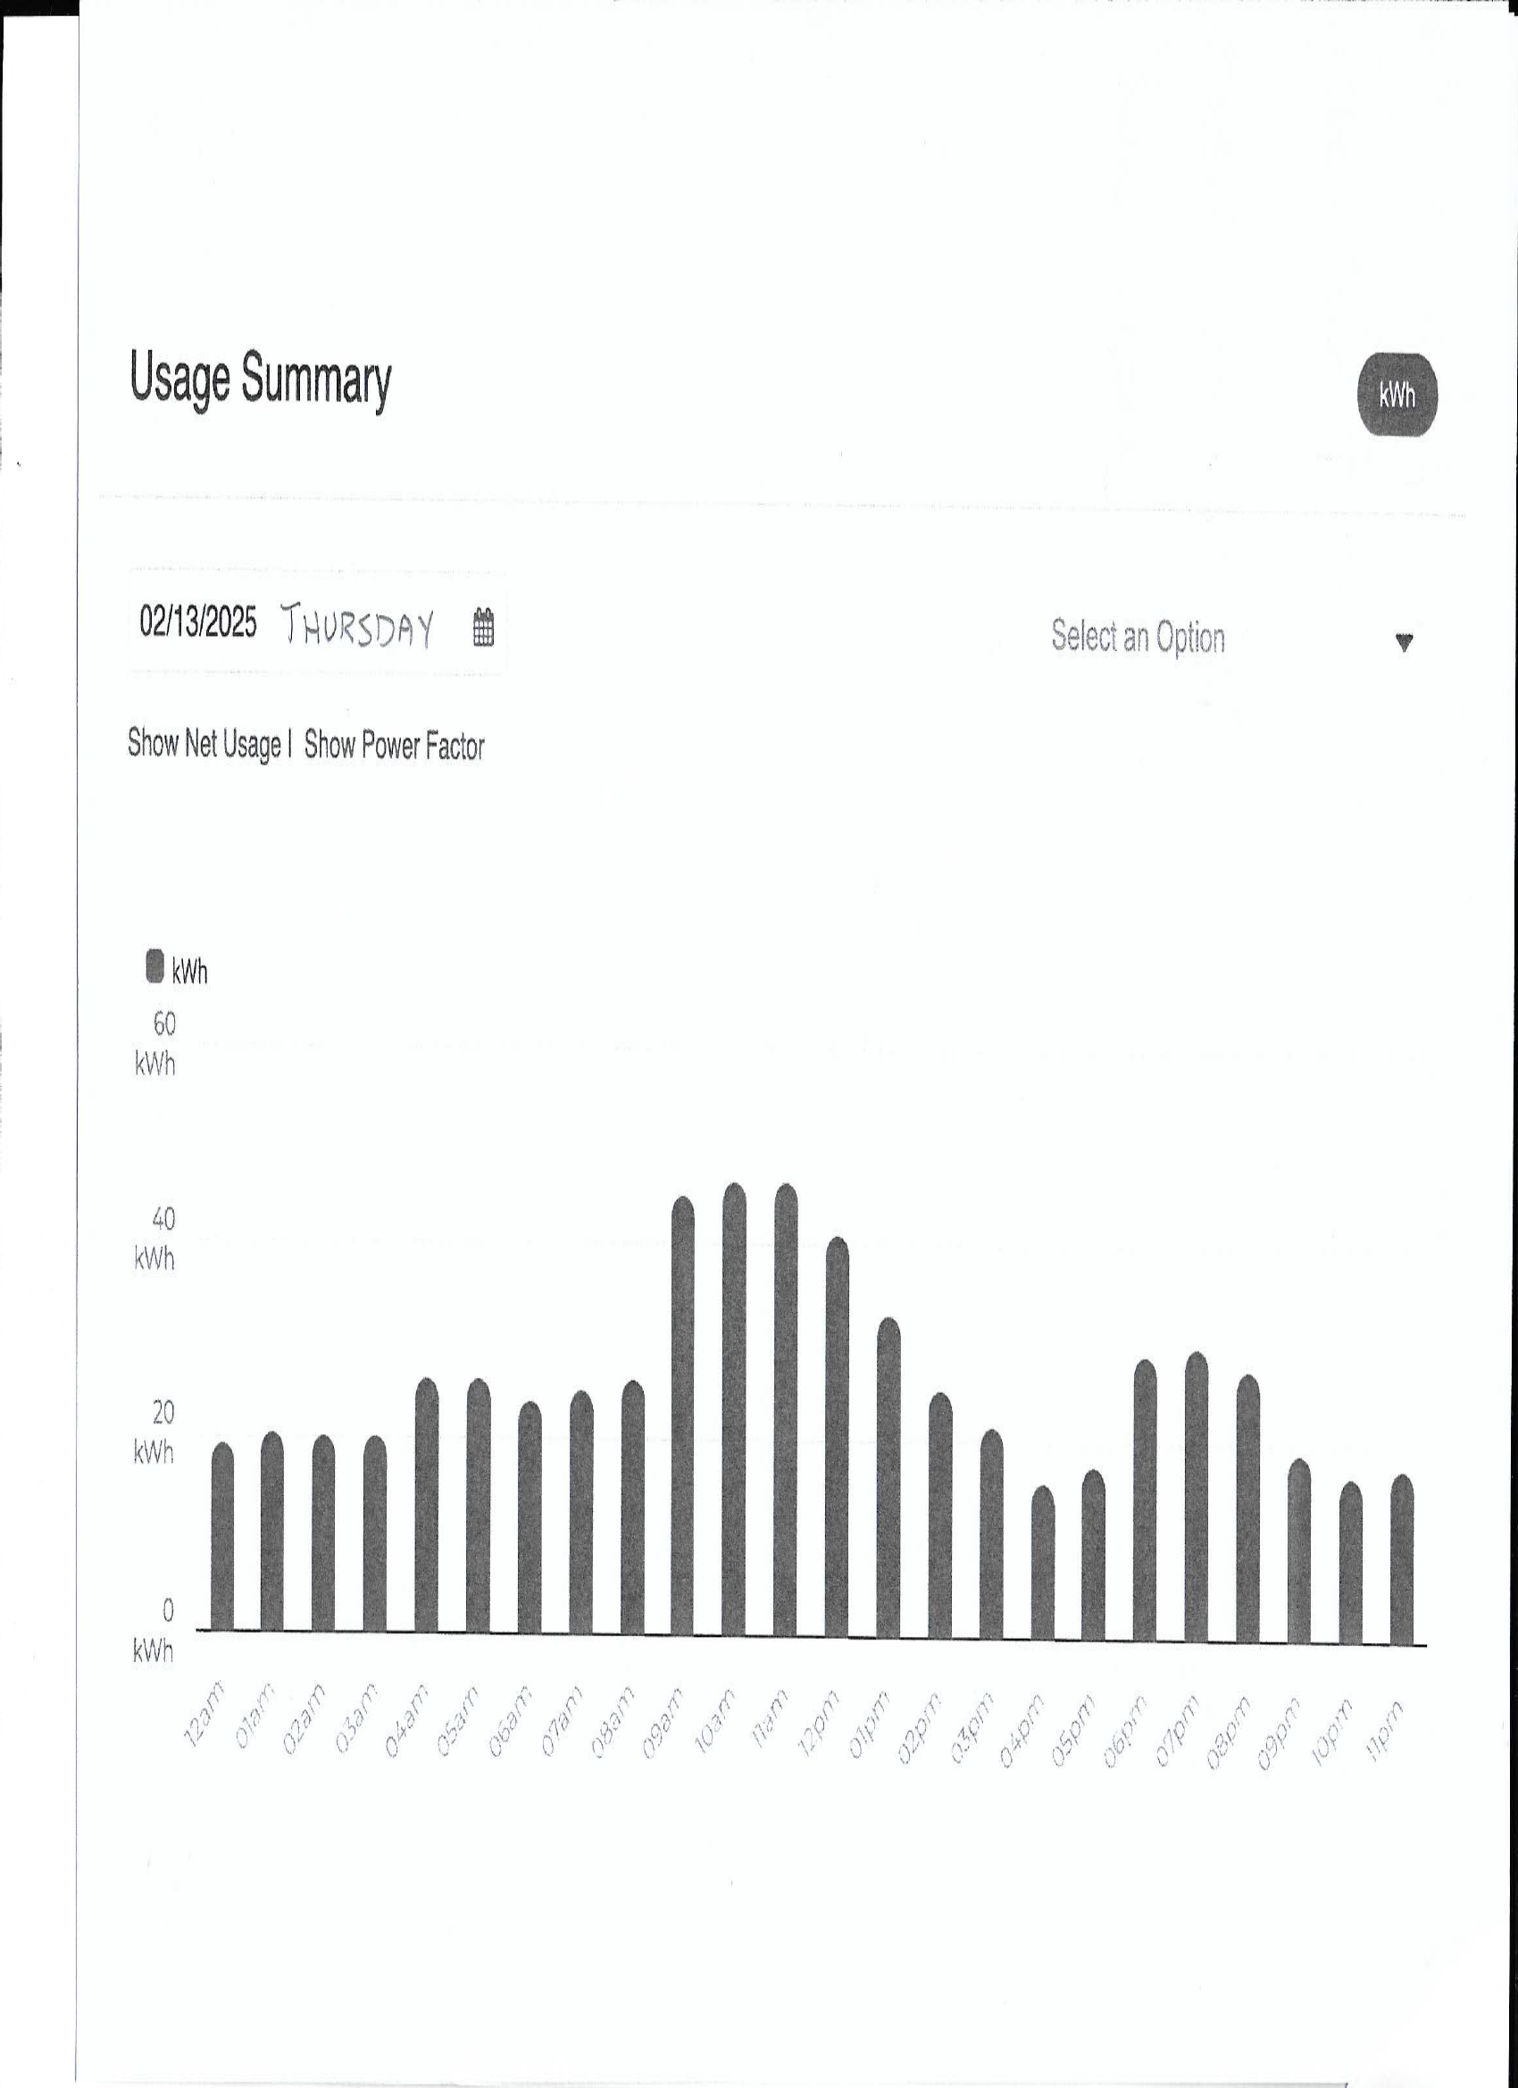
How and When We Use Electricity
9am
11am
7pm
Solar helps us reduce these peaks—and our monthly bill
Notes:
This chart shows our electricity use over a single day, broken down by 15-minute intervals.
You can see that our power usage spikes in the late morning and early evening—exactly when Xcel measures our demand charges.
And remember, demand charges make up about 70% of our bill.
This is why solar matters so much—it can help shave down those peaks, lower our demand charges, and reduce our bill more than just lowering energy use alone.”

Slide 21
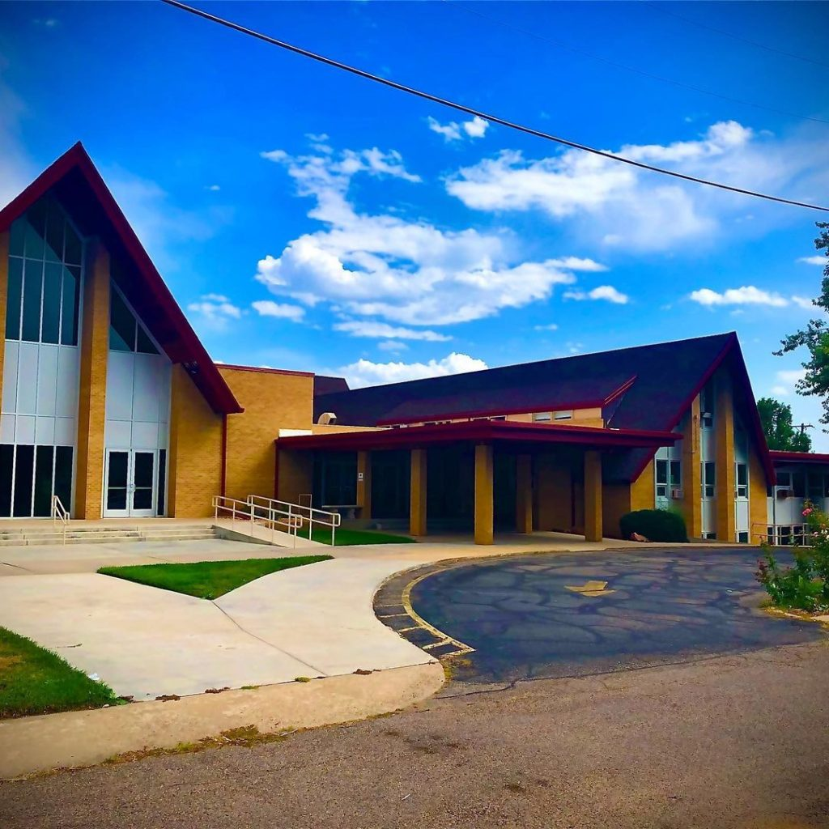


What Are Others Saying About Solar?
“Our solar project made sense both theologically and financially."
– Rev. Ben Hensley, Lakewood UMC
Notes:
Other churches have done this. One pastor, Rev. Ben Hensley at Lakewood UMC, said:
‘Our solar project made sense both theologically and financially.’
That’s exactly what we’re trying to discern here.

Slide 22
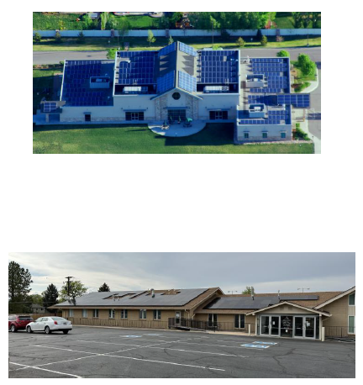
Who Else Has Done Projects With Complete Energy Solutions?
Family in Christ Community Church
11355 Sheridan Blvd
Westminster, CO 80020
Contact: Randy Borden
System Size: 96kW
Arapahoe Road Baptist Church
780 E. Arapahoe Rd.
Centennial, CO 80122
Contact: Wayne Peterson
System Size: 56kW
Notes:
The trustees felt that we wanted a solar installer that had good references, especially those who had worked with the unique situations with churches.
Complete Energy Solutions, the company we’ve been working with, has done successful installations for several other congregations here in Colorado.
This is Family In Christ Community Church in Westminster. They installed a 96 kilowatt system with CES about 10 years ago—and it’s still going strong. Their team has been happy to share their experience and feedback. Below that is Arapahoe Road Baptist Church in Centennial. They completed their solar project just last year with CES. It’s already saving them money.
We believe that these churches show that CES understands the unique needs of faith communities, and they have real experience helping churches go solar successfully

Slide 23
What Will the Installation Look Like?
A total of 371 panels will be installed on the south-facing roof.
Inverters will be installed on the south wall
The renderings of the installation from CES are depicted on the following page.
Minimal aesthetic impact; professionally installed.
Notes:
On the next slide, we have a mockup from CES as to what the panels will look like and where they are placed.

Slide 24
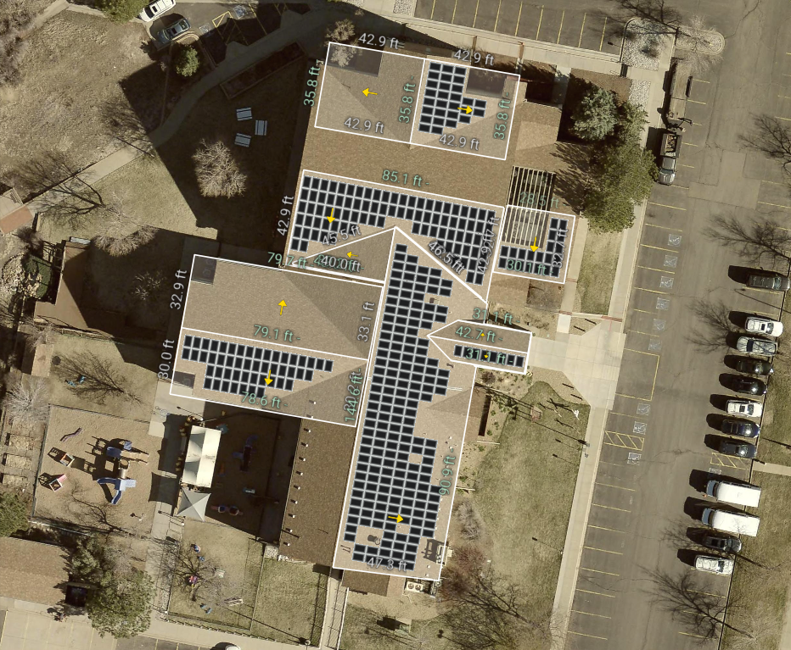
Notes:
Here’s a top-down view of St. Luke’s with a rendering of the proposed solar installation.
As you can see, panels would be installed on several of the south-facing and flat roof sections of the building. These areas were chosen for optimal sun exposure and energy generation throughout the year.
The layout was designed to be both efficient and visually unobtrusive. From the ground level, many of these panels will barely be noticeable—especially the ones on the flat roof sections.
This design comes from our solar provider, Complete Energy Solutions, and represents the configuration that delivers the highest projected energy output for our site.
It’s also worth noting that the roof is in excellent condition—it was replaced after a hailstorm in late 2023—so we’re well positioned to support this installation without additional repair work.

Slide 25
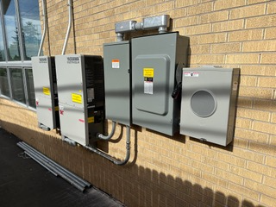
Inverters
to be installed
on South wall
Notes:
This photo shows two typical power inverters mounted on a church building. For our system at St. Luke’s, we will have a total of six inverters, which will likely be split between two south-facing walls of the building.
These inverters play a key role by converting solar energy into usable electricity for our building.
Wall-mounted inverters were a deliberate choice—they’re easier to maintain and replace over time, compared to roof-mounted equipment.
The final installation will look very similar to this: clean, low-profile, and located along exterior walls that already house utility equipment.

Slide 26
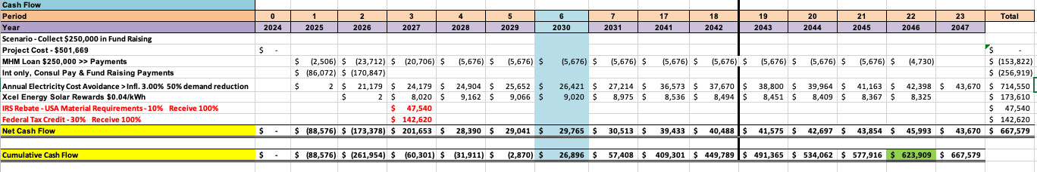
Projected Cash Flow Model
SCENARIO 1:
Includes $250,000 in Donations · Assumes 40% Federal Tax Credit Received
Total net benefit: $623,909 over 22 years
Net cash flow turns positive in Year 3 (2027)
Cumulative cash flow begins in Year 6 (2030)
NOTE:
Net cash flow shows whether the project saves money in a given year.
Cumulative cash flow tracks the total savings over time, turning positive only after all initial costs are paid back.

Slide 27
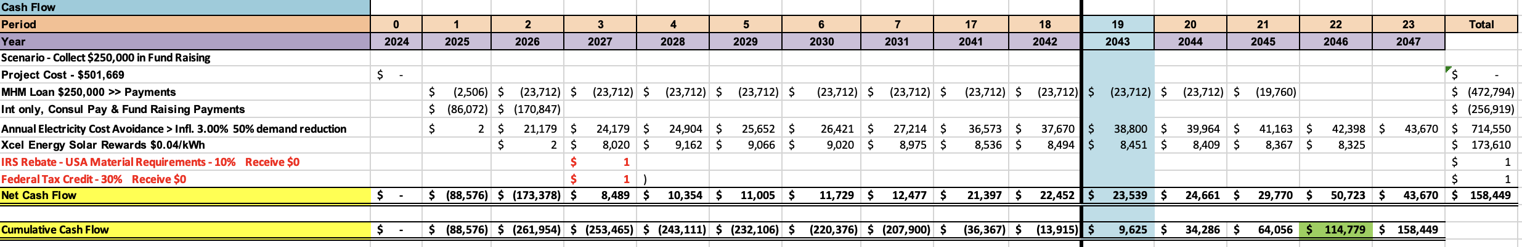
Projected Cash Flow Model
SCENARIO 2:
Includes $250,000 in Donations · Assumes 0 Federal Tax Credit Received
Total net benefit: $158,449 over 23 years
Net cash flow turns positive in Year 3 (2027)
Cumulative cash flow turns positive in Year 19 (2043)
NOTE:
Net cash flow shows whether the project saves money in a given year.
Cumulative cash flow tracks the total savings over time, turning positive only after all initial costs are paid back.

Slide 28
How Solar Changes Our Electric Bill
A Smart Meter was installed by Xcel Energy in October 2024
Allows us the ability to track our electrical usage by hour, day, etc.
Current Billing
Demand Rates:
Spring, Fall, and Winter $18.47/kW
Summer$24.50/kW
Energy Rate: $0.00853/kWh
Charge Basis: All usage, any time during the billing period
Solar Billing
Demand Rates:
Spring, Fall & Winter: $12.14/kW
Summer: $13.30/kW
Charge Basis: Highest 60-minute usage Monday-Friday from 3pm to 7pm during the billing period
Energy Rate:
On-peak Monday-Friday 12-8pm $0.11945/kWh
Off-peak $0.02115/kWh
Excess production will be banked, used for less or zero production times
Why It Matters:
Lower demand rates
Limited peak charge window
Ability to store and reuse solar energy
Adds up to thousands in annual savings

